Slide 1

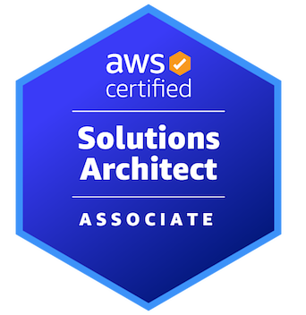

AWS CERTIFIED SOLUTIONS ARCHITECT - ASSOCIATE
Authentication and Authorization Identity and Access Management (IAM)
AMBER ISRAELSEN
Developer | Technical Trainer
Notes:
m3-01 = “Module Introduction”
Hi folks, and welcome to this next module in the AWS Certified Solutions Architect Associate course. I’m Amber Israelsen.

Slide 2
Course Outline (Part 1)
Course Introduction
AWS Cloud Practitioner Refresher
Authentication and Authorization – Identity and Access Management (IAM)
Compute
Elastic Load Balancing and Auto Scaling
Networking
Storage
Databases
Data Migration and Transfer
Analytics
Notes:
In the last module, we did a refresher of the core concepts from the Cloud Practitioner content.
Coming up in this module, we’ll get into authentication and authorization, with the main focus being Identity and Access Management, or IAM. Some of this might also be review for you—like users, groups and roles—so feel free to skip through those if you’re already comfortable with them. But then we’ll get into a little more detail about things like identity and resource-based policies, account federation and how to manage multiple accounts.
Let’s get started.

Slide 3

Identity and Access Management (IAM)
Service used to securely control access to your AWS resources
Controls authentication (who) and authorization (what they can do)
Notes:
m3-02 = “AWS Identity and Access Management (IAM) Overview”
In this module, there’s one core service that really sits at the center of everything else, and that’s Identity and Access Management, or IAM.
In short, this is (click) a service that’s used to securely control access to your AWS resources.
It (click) controls authentication (the WHO) and authorization (the WHAT they can do)
Go out to Console – show the left nav (users, groups, roles, policies)
Going out to the console, you’ll see a few different constructs here—user groups, users, roles, policies and some other things. Using a combination of these concepts, you’ll be able to secure your AWS environment, and control who does what.

Slide 4
1
Users
2
User Groups
3
Roles
4
Policies (and attach them)
Notes:
m3-03 = “DEMO: Creating IAM Users”
We’ll start our discussion by digging into IAM users more.
In Console, navigate to IAM.
Create a new IAM user (do both from same screen)
michael.scott
dwight.schrute
Console access (no programmatic)
Password:
Don’t add groups or policies
On the Review screen, point out that by default, users have no permissions.
On the Success screen, here are instructions for how to log in, and you can also download a CSV with this information. You can also email login instructions to these folks.
Copy the Console access URL to the clipboard
Username: pam.beasley
Console access and programmatic access
Password:
Don’t add to groups
Don’t add policies

Slide 5
Root User vs. IAM User
One per account
Unrestricted access
Difficult to restrict or revoke access
Can perform the following tasks:
Close an AWS account
Change an AWS support plan
Change AWS account settings
Multiple per account
Users can be deleted or disabled
Easy to restrict access
Notes:
Another really important concept to understand for AWS is the difference between a root user and what’s called an IAM user. We saw this briefly when we went to log into the AWS Management Console in an earlier demo.
A root user is the all-powerful user that is created when you create an AWS account. This account has full access to all AWS services and resources, including billing information, and it’s difficult to restrict or revoke that access if you decide you need or want to.
And for the exam, you may get questions about specific tasks that require Root user permissions, and those would include:
Close an AWS account
Change an AWS support plan
Change AWS account settings, such as the account name, email address, root user password and keys
An IAM user (click), on the other hand, is a user that is created by the root user. You can have many of these per AWS account. For example, as a root user, I can create accounts for John, Mary, Dinesh, and Simon. Those would be IAM accounts. It’s easy to delete or disable these, and it’s also easy to restrict access.

Slide 6
BEST PRACTICES
Always work in your IAM account, not the root account
Set up IAM users with least number of permissions needed
Notes:
As a general best practice, you shouldn’t use the root user account for your day-to-day work. Instead, create an IAM user account for yourself with the least number of privileges you need to do your work, then reserve the root account for special administrative tasks that can’t be done any other way.
In most organizations, your company will have an account set up already, and they will assign you an IAM login with appropriate permissions to accomplish what you need to accomplish in your job.

Slide 7
1
Users
2
User Groups
3
Roles
4
Policies (and attach them)
Notes:
m3-04 = “DEMO: Creating IAM User Groups”
Now let’s look at IAM groups quickly. As you might expect, a user group is a collection of users.
New group
Name: Developers
Add Pam
Skip policies for now
New group
Name: Testers
Add Dwight
Skip policies for now
Create group: Admins
Add Michael
Skip policies for now
Okay, we have users and groups now, and I think those are fairly straightforward (show in UI that we have three users, three groups).

Slide 8
1
Users
2
Groups
3
Roles
4
Policies (and attach them)
Notes:
m3-05 = “IAM Roles”
And we’re checking the top two things off the list here…
But there’s another construct here called Roles (click on this in Console). What’s that?
If you read at the top here, it’s an identity you can create that has specific permissions with credentials that are valid for short durations. Roles can be assumed by entities that you trust.
In plain English…go to next slide…

Slide 9
Role
Similar to a user (an identity with permissions)
Does not have credentials (password or keys)
Assumable, temporarily, by anyone who needs it
Notes:
(click) A role is similar to a user, in that it’s an identity that can have permissions to do things in the system.
(click) BUT a role does not have credentials as you might traditionally think of them—there’s no password or keys or anything like that.
(click) And a role can be assumed, temporarily, by anyone or anything that needs it.
If that doesn’t make it any more clear, let’s talk through an example to hopefully illustrate why roles even exist.

Slide 10



S3
EC2
CloudWatch
Notes:
Say that you’re creating an EC2 instance, or a virtual server—to host an application. And that application needs (click) to be able to use the Simple Storage Service for storing and retrieving pictures, for example, and it also (click) needs to publish logs to a service called CloudWatch. Don’t worry if you don’t understand much about these services yet. Just know that you have one service in AWS trying to interact with other services in AWS.
That’s a pretty common scenario, right? But, how do you go about this from an IAM perspective. Well, there are a couple options.

Slide 11
OPTION 1
Create an IAM user for the application with appropriate permissions
Hard-code user credentials in the application or on the EC2 instance’s file system and retrieve them at runtime
S3
EC2
CloudWatch
Notes:
Option 1 is to create an (click) an IAM user for the (click) application that has the appropriate permissions to use S3 and CloudWatch.
Then (click) hard-code those credentials into the application or store them on the EC2 instance’s file system and retrieve them at runtime.

Slide 12

Notes:
Now, even if you don’t know how all of this works, that option should hopefully intuitively feel like this to you!
Hard-coding credentials and/or storing them on a file system is never a good idea.

Slide 13
OPTION 1
Create an IAM user for the application with appropriate permissions
Hard-code user credentials in the application or on the EC2 instance’s file system and retrieve them at runtime
S3
EC2
CloudWatch
Notes:
So let’s agree that this isn’t really an option at all. But this scenario is really why roles exist.

Slide 14
OPTION 2
Create an IAM role for the application with appropriate permissions
When creating the EC2 instance, assign it this role
No credentials required
S3
EC2
CloudWatch
Notes:
The second option (click)—and honestly, really the ONLY option—is to create an IAM role (click) with the appropriate permissions for S3 and CloudWatch.
Then when you go to create your EC2 instance (click), or server, you assign it that role.
By doing this, the EC2 instance assumes (click) this role and will have access to S3 and CloudWatch, no credentials required.
This is a much better way to go!

Slide 15

ROLE
Notes:
To build on this concept a little more, let’s use a hat analogy for a role…

Slide 16

A Real-Life Analogy
Parent
Software Engineer
Soccer Coach
Home Chef
Therapist
Notes:
In real life, you’ve probably heard the expression about someone wearing a lot of hats. In your own life, maybe you juggle different hats or roles of being a parent and a software engineer at work, maybe a soccer coach on the weekends, the home chef for yourself or the family, and maybe a therapist to your friends.
You wear a lot of different hats and play a lot of different roles depending on the day or the hour.

Slide 17
An AWS Example
Read from S3, write to CloudWatch, read from DynamoDB
Read from S3
Write to CloudWatch
EC2
Notes:
Roles in AWS are similar.
You can assume a role by putting on that hat. And when you put on that hat, you can do everything the role can do.
Maybe (click) there’s a role that says you can read from S3, write to logs to CloudWatch and read from a DynamoDB database. That’s one role that does all those things.
Or maybe (click) there’s a role that can only read from S3. Or another (click) role that can only write to CloudWatch.
Whatever hat you put on, or whatever role you assume, that’s what you can do.
On the exam, if you get a question about one service needing permissions on another service, then a Role is the first thing you should think about.

Slide 18
An AWS Example
Read from S3, write to CloudWatch, read from DynamoDB
Read from S3
Write to CloudWatch
User
Notes:
But the same is true of users or groups. They can assume roles too, and it works the same way—temporarily, the user would be able to do whatever things the role can do.

Slide 19
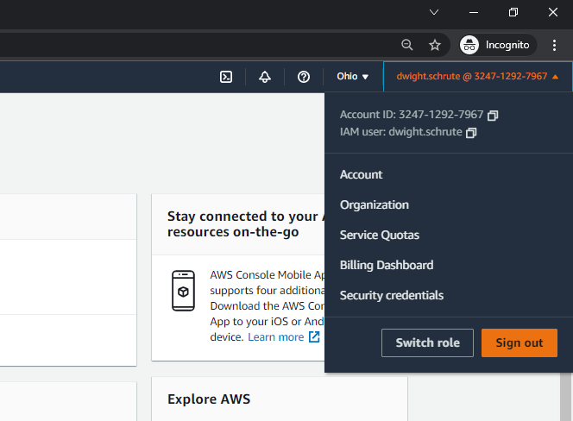
Notes:
If you go out to the Console, you’ll see you as a user can switch roles easily right here on the top right menu.

Slide 20

IDENTITIES (the “Who”)
USER
USER GROUP
ROLE
Notes:
So to summarize what we have so far, these are the identities or the “WHO” is doing something with our AWS resources—users, user groups and roles.

Slide 21

I can’t do anything.
Notes:
But as we saw earlier, just having an identity doesn’t mean I can do anything. In fact, by default, you can’t do ANYTHING.
If we log in as our IAM user Dwight and try to get to S3, for example, you’ll see we can’t really do anything—can’t list buckets, can’t create new ones, etc.
Now we need to tie everything together, and hit this final construct (show in Console) of policies.

Slide 22
1
Users
2
Groups
3
Roles
4
Policies (and attach them)
Notes:
m3-06 = “IAM: Policies”
And the final number in our list here…

Slide 23
JSON
POLICY
Who can do what to which resources and when
Notes:
Simply put, a policy says who can do what to which resources and when.

Slide 24
JSON
POLICY
“Allow IAM users to rotate their own credentials programmatically and in the console.”
Notes:
For example:
“Allow IAM users to rotate their own credentials programmatically and in the console.”

Slide 25
JSON
POLICY
“Allow a user to start and stop EC2 instances.”
Notes:
“Allow a user to start and stop EC2 instances.”

Slide 26
JSON
POLICY
“Allow a Lambda function to access a DynamoDB table.”
Notes:
“Allow a Lambda function to access a DynamoDB database table.”

Slide 27
{
"Statement": [
{
"Effect":"effect",
"Action":"action"
"Resource":"arn"
"Condition":{
"condition":{
"key":"value"
}
}
}
]
}
Notes:
Here’s the basic syntax of a policy.

Slide 28
{
"Statement": [
{
"Effect":"effect",
"Action":"action"
"Resource":"arn"
"Condition":{
"condition":{
"key":"value"
}
}
}
]
}
Allow or Deny
Default is Deny
Notes:
For effect, your two options are Allow or Deny.
Deny is the default that’s automatically applied. So if you don’t specify anything, it’ll be defaulted to Deny.

Slide 29
{
"Statement": [
{
"Effect":"effect",
"Action":"action"
"Resource":"arn"
"Condition":{
"condition":{
"key":"value"
}
}
}
]
}
Corresponds to API calls to AWS services
Example:
s3:DeleteBucket
Notes:
And then the action. This is going to correspond to the API calls to AWS services. An API call is basically just the code that your application calls to do something in AWS. Such as for s3, the ability to Delete a Bucket.

Slide 30
{
"Statement": [
{
"Effect":"effect",
"Action":"action"
"Resource":"arn"
"Condition":{
"condition":{
"key":"value"
}
}
}
]
}
Amazon Resource Name
The resource name you want to apply permission to
Example:
arn:aws:ec2:*:*:instance/instance-id
Notes:
Then you have the arn, or Amazon Resource Name. This is the resource you want to apply the permission to.
For example, you want to apply permissions to a specific ec2 instance, and you’d enter the ID for that instance.

Slide 31
{
"Statement": [
{
"Effect":"effect",
"Action":"action"
"Resource":"arn"
"Condition":{
"condition":{
"key":"value"
}
}
}
]
}
Optional conditions to control when this policy is in effect
Example:
{ "StringEquals" : { "aws:username" : "johndoe" }}
Notes:
And then finally, conditions. These are optional, and they control when the policy should apply.
For example, only apply this policy is the user name is john doe.

Slide 32
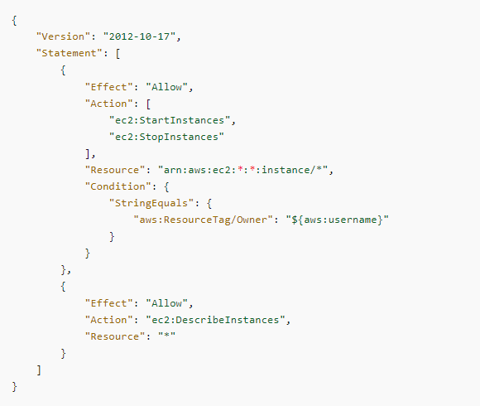
Policy Example
Notes:
Now let’s apply those concepts to an example policy.
Here we’re saying that if (click) the IAM user is equal to whatever user name we specify here in the condition
This person (click) is ALLOWED to…
Start (click) start and stop EC2 instances—once again, those are your servers that live in AWS…
And (click) the asterisks here mean they can start and stop any instances, not just a specific instance.
And then we also (click) need to be able to Describe, or list, Instances, which lets us check the status of instances.
Looking at another example in the Console, let’s look at perhaps the simplest one, or at least the most permissive one, of AdministratorAccess (point out JSON vs. policy summary tabs)
This one basically says allow every action on every resource in the account.

Slide 33
DEMO
Creating IAM Policies
Notes:
m3-07 = “DEMO: Creating IAM Policies”
Let’s go create an IAM policy out in the AWS Console.
Navigate to IAM→Policies
Before we create our own policy, it can be instructive to look at some of the existing policies. Filter by S3. Click into AmazonS3ReadOnlyAccess.
Look at visual designer
-Here we’re saying we have full list access and limited read access
-If we click into the S3 link, you’ll see the List actions that you can take. And these actions are just API calls. And then all the various read actions, starting with Get.
If we look at the JSON for this policy, you’ll see we’re allowing Get* and List*, which matches up with what we saw in the policy summary. And then there are also some s3-object-lambda Get and List actions allowed too.
So that’s an example of a managed policy that you get out of the box. But you can also create your own policies as well.
Policies→Create policy
Service: S3 (there ARE already managed policies for S3, and you’d probably just want to use those, but if you need something very tailored to your situation, I want to show you how to create a policy from scratch)
Access Level: List→ListAllMyBuckets (click on question mark to show what it does)
Resources: In this case, defaults to all, but if you chose something else above (show with ListBucket), then you might have checkboxes here to choose specific resources.
Conditions: These are optional, and we’re not going to specify here, but you’ll see some examples (show) of what you could use.
Next, next
Name: MyCustomS3Policy
Create

Slide 34
I still can’t do anything.
Notes:
Okay, those policies are great. We just created one for S3 tagging, and there are lots of existing policies for S3. But even though they’re out there and defined, Dwight is reminding us that at this point, he still can’t do anything. And he’s correct.

Slide 35
JSON
POLICY
Who can do what to which resources and when
Notes:
m3-08 = “DEMO: Attaching IAM Policies”
The WHO…this comes from attaching a policy.

Slide 36
1
Users
2
Groups
3
Roles
4
Policies (and attach them)
Notes:
As mentioned here in our list…

Slide 37

The “Who” Identities
POLICY
POLICY
POLICY
USER
USER GROUP
ROLE
Notes:
So we want to take the policies we’ve been talking about and attach them to users, users groups or roles. So let’s go do that.
In the console, we could attach an S3 permissions directly to Dwight…show this…attach existing policies directly
But remember, we also have Dwight in a group (show this) of Testers, and it’s generally better to manage things at the group level so that all testers have the same permissions.
On the Testers group, attach policy
AmazonS3FullAccess
Now show that Dwight can do everything in S3 (under his login, refresh the page).
For the Developers group, let’s go attach a few policies there…
-Attach S3FullAccess and AmazonDynamoDBFullAccess and AWSLambda_FullAccess
And for the Admin group, let’s attach AdministratorAccess policy.

Slide 38
1
Users
2
User Groups
3
Roles
4
Policies (and attach them)
Notes:
Okay. So to wrap things up…
(click) We talked about users and users groups. Users are just like you’d think—Michael Scott or Dwight Schrute.
Users can be part of groups, and you can give everyone in the group the same permissions.
Roles (click) let you temporarily assume permissions, without needing credentials. A common use case here is that an application on an EC2 instance needs to assume permissions that allow access to S3 and CloudWatch.
And finally (click), the actual permissions are defined in the policy—whether you want to allow someone to read from S3 or write to a DynamoDB table, it’s all specified here. And then the glue that holds it all together is to attach the policy to one of the identities—the user, group or role.

Slide 39
Security Token Service (STS)
Enables you to request temporary, limited-privilege credentials for IAM or federated (external) users
Notes:
m3-09 = “Security Token Service (STS) Overview”
Next up, let’s talk about a core service that works behind the scenes with identity and access management, and that’s the Security Token Service, or STS.
With this service, you can request temporary, limited-privilege credentials for an IAM user or federated user that are coming from an external system, like a corporate directory or even something like Facebook or Google as the identity provider.

Slide 40

Assuming a Role with STS
DEV ACCOUNT
PROD ACCOUNT
1
Call STS:AssumeRole
IAM/STS
Return temporary credentials
2
Privileged Access Role
3
Delete EC2 instance using temporary credentials
IAM User
“I need to delete an EC2 instance in production.”
4
Credentials automatically expire 15-60 minutes
EC2 Instance
Notes:
So maybe you have something like this. Am IAM user in a development account needs to delete an EC2 instance that lives in production. Now, generally you don’t want to just give folks destructive permissions like this by default because you don’t want them accidentally, or even maliciously deleting things like EC2 instances. Instead, you want them to temporarily assume a role, go take the action, and then have those temporary credentials expire. And the Security Token Service makes that possible.
So using the API (click), or going through the Console, we make a call to STS to AssumeRole—this is probably the most frequently used call on STS. And we say, we want to temporarily assume this role—some role that’s already defined and has the permissions we need to delete the EC2 instance. STS (click) then returns temporary credentials to the user. And then (click) the user can make the call or make the clicks to delete the EC2 instance.
And then the (click) credentials will automatically expire. The duration varies by what you’re trying to do and how you requested the credentials, but between 15 minutes and 1 hour, so a short time.
Now, I should note that STS doesn’t HAVE to be used across accounts. Maybe you just need temporary elevated privileges in the same dev account…STS works for that as well. Or if you’re coming in from a Facebook login or some other identity provider, that’s supported as well. So STS is really central to permissions in AWS.

Slide 41
DEMO
Switching Roles in the AWS Console
Notes:
SETUP:
Be logged in as root in one browser (Chrome); have Dwight logged in in another browser (Edge)
If Dwight has permissions from previous demos, remove them
m3-10 = “DEMO: Switching Roles in the AWS Console”
Now that we’ve seen the basics of how the Security Token Service works, let’s go take a look at how someone might use this to switch roles in the AWS Console.
I’m here in the AWS Console, logged in with my root user.
Show: Have created IAM user: dwight.schrute, doesn’t have any permissions.
Dwight is logged in in another browser. Try navigating to S3 and see he doesn’t have permissions. But say that Dwight occasionally needs admin permissions to do whatever he wants.
Now, disclaimer: this scenario is a little bit contrived. In the real world, a best practice is to create IAM user groups, grant appropriate permissions to the group, and then add users to those groups. But for purposes of showing you how to switch roles, we’re going to be working directly with Dwight as an IAM user.
Roles: Create one AdminRole (select AWS Account), give AdministratorAccess policy
Now, just because we have that role created doesn’t mean that Dwight can assume that role. We need to grant him that ability.
We’ll do that by (on his user) adding an inline policy that allows him to assume the role, name it AdminRolePolicy:
{
"Version": "2012-10-17",
"Statement": {
"Effect": "Allow",
"Action": "sts:AssumeRole",
"Resource": “COPY IN THE ARN FROM THE ROLE*"
}
}
Provide Dwight with the account number and role name (AdminRole)
Now back in Dwight’s browser, up on the to right, click the down arrow and Switch role. Enter the account number, role name and then choose a color—this will highlight around the role name, as I’ll show you in a minute. Switch.
Now if we try to navigate to S3 or anywhere else, we have permissions to do that because we’re getting the permissions of an Administrator effectively while we’re using this role. And then I could switch back to Dwight’s regular IAM user at any point (show). Or if I don’t switch back, those credentials will automatically expire, and that admin access will no longer work.
So the Security Token Service is working behind the scenes there, and there are API calls to AssumeRole and other things happening that we don’t see from the browser experience here. But you can also do all of this in code using those same API calls directly to STS.

Slide 42

AWS Identity and Access Management (IAM)
Notes:
m3-11 = “Identity Federation”
Okay. We’ve seen how you can add and manage users and groups in IAM. And that (click), of course, gives them access to do things in AWS. But what if you have hundreds or even thousands of employees or users, and you don’t want to set them all up through IAM?

Slide 43
Active Directory
AWS Identity and Access Management (IAM)
Google
Notes:
What if you already have a corporate directory like Active Directory where you manage all your users? Or what if you want to use an external provider like Google or Facebook, something like that?

Slide 44
Identity Federation
Active Directory
AWS Identity and Access Management (IAM)
Google
Notes:
Well, those scenarios are totally supported with AWS, and this is called identity federation, where you’re managing user identities outside of AWS and then giving the external identities permissions to use AWS resources in your account.
Depending on the identity provider you’re using, there are some nuances in how this works, but at a high level, it’s this…

Slide 45
Identity Federation
2
Logs in
Identity Provider
(e.g., Active Directory, Google)
Returns credentials
3
User
1
Establish trust with identity provider
4
Access AWS
Notes:
First, we need to establish trust between our AWS account and the identity provider—whoever that is, whether it’s Active Directory, Google, Facebook, or what have you.
(click) Then our user’s going to log in to that identity provider. The provider will then return (click) credentials, and with those credentials (click), we can access AWS. So there’s this extra step of getting credentials from the identity provider before doing what you need in AWS.
That’s the big picture.

Slide 46
Identity Providers
Amazon Cognito
Recommended for mobile and web-based applications
Does most of the behind-the-scenes work for you
Supports anonymous sign-ins
Web Identity Federation
No longer recommended, but works with Amazon, Facebook, Google, or any provider compatible with OpenID Connect (OIDC)
SAML 2.0
Older way of doing things
Examples: Active Directory, Active Directory Federated Services (ADFS)
Custom Identity Broker
Use when identity provider is not compatible with SAML 2.0
Notes:
AWS supports many different ways to do federation and with many different types of identity providers.
The recommended way to do federation for mobile and web-based applications is to use Amazon Cognito. Cognito will do a lot of the behind-the-scenes work for you with the provider, so it’s going to be a lot easier to set up and maintain. And Cognito also supports anonymous sign-ins. We’ll take a look at a Cognito example here in a minute.
If you have a more advanced scenario where you need more control, or for some reason, you just can’t work with Cognito, then you can use Web Identity federation. This will work with any provider that’s compatible with OpenID Connect, or OIDC, and this includes providers like Amazon, Facebook and Google.
SAML 2.0 is another option. This is a slightly older way of doing things, but it’s still supported. So if you’re already using a provider that supports SAML 2.0, you can set up trust between that provider and AWS, and you can then provide single sign-on access to the console, or API access for various other operations. The most common examples of providers here are Active Directory and Active Directory Federated Services (ADFS).
And then finally, if SAML doesn’t work for your situation, you can build a custom identity broker application to perform a similar function. The broker application will authenticate your users, requests temporary credentials from AWS, and then give them access to AWS resources using those credentials.

Slide 47




Cognito with a Mobile App and Google Login
1
Launches the app
Exchange Google token for Cognito token
3
User
2
4
Cognito
Identity Pools
Redirects for authentication and a token
Exchange Cognito token for temporary AWS credentials
Identity Provider
5
STS
Access AWS resources using temporary credentials
S3
Notes:
Since Cognito is the recommended way to do federation these days, let’s spend just a minute on an example. Let’s say we have a mobile application that needs to access objects in an S3 bucket. And we don’t want to set up the end users with IAM accounts, but instead, we want to use Google as our identity provider.
(click) 1. So we’ll start with our user, who’s going to launch the mobile app and be prompted to log in
(click) 2. The app will then redirect to Google to authenticate the user and get a token
(click) 3. Then using the Cognito APIs, the app will exchange the Google ID token for an Amazon Cognito token. And I should mention, prior to all of this, Cognito should have been configured to trust Google as an identity provider. And in Cognito, you have a concept of an identity pool, which gives your application users temporary, controlled access.
(click) 4. We then exchange the Cognito token for temporary AWS session credentials that we get from the Security Token Service, or STS.
(click) 5. And finally, those temporary AWS credentials can be used to access any AWS resources required by the app. In this example, we’re using S3, but it could be DynamoDB or RDS or what have you.

Slide 48
Active Directory
Microsoft’s proprietary directory service
Runs on Windows Server
Used to manage permissions and control access to network resources
Data is stored as objects
Users
Groups
Applications
Devices
Notes:
m3-12 = “AWS Directory Services Overview”
We’ve touched on Active Directory a couple of times in previous clips, but let’s get into a little more detail about the support we have for AD in AWS.
If you don’t already know, Active Directory is Microsoft’s proprietary directory service. It runs on Windows Server, and it’s used to manage permissions and control access to network resources. For example, if you get a job at a company that’s a Microsoft shop (as they say), an administrator will go into Active Directory, set up a user account for you, give you access on various things, and this is what allows you to log in to your computer on the first day of the job. It’s roughly analogous to AWS’s IAM, except it’s from Microsoft, and it’s a little broader (click) in that you can use it to manage computers, printers, file shares and so on.
Active Directory is very popular in business today, even if a company isn’t necessarily a Microsoft shop.

Slide 49
AD
??
AWS
Notes:
So if you’re looking to move to AWS, or you’re already IN AWS and wanting to integrate with Active Directory, how do you make them play nicely together?
Well, if you go out to the AWS Console, and go to Directory Service (do), Set up directory, you’ll see the directory types: AWS Managed Microsoft AD and AD Connector. There’s also Amazon Cognito User Pools, which allows users to register and sign-in to your apps. We covered Cognito a little earlier in the Federation section, so I’m not really counting that as a type of Active Directory here.
So let’s focus on these first two, and go back to the slides to explain a bit more…

Slide 50


Directory Service Types
AWS Managed Microsoft AD
AD Connector
Managed Active Directory in the cloud
Can connect to/trust an Active Directory on-premises
Users authenticating to AWS can be looked up on-prem and vice versa
Controls how SharePoint, .NET and SQL Server workloads in a VPC connect to AWS
A proxy to redirect requests to on-premises Active Directory
Users are managed on-premises
Authentication→
Established Trust
←Authentication
←Authentication
Users
Users
Proxy
Users
On-Prem AD
AWS Managed Microsoft AD
On-Prem AD
AD Connector
Notes:
There are two options here.
First is AWS Managed Microsoft AD. Here, you basically create your own Active Directory in AWS. But you CAN connect to and trust Active Directory on-premises, which means that if someone tries to authenticate to AD in AWS, and they’re not there, we can look them up in the on-prem AD, and vice versa. So user information can be stored across on-prem and cloud.
And you’d also use this to control how SharePoint, .NET and SQL Server workloads in a VPC connect to AWS. So on the exam, if you get questions related to how Microsoft technologies in a VPC interact with AWS resources, then think AWS Managed Microsoft AD.
Here’s a visual to (click) hopefully help. So you’ve got your on-prem AD and AWS Managed Microsoft AD. There’s a trust (click) relationship between them. And you can set up (click) and manage users in both places, which means users can authenticate from either direction—either into AWS AD or on-prem AD, and you can do look-ups going both directions.
AD Connector, on the other hand, is basically a proxy to redirect to on-prem Active Directory. So you don’t have two instances of AD here. You just have on-prem, and that’s where you’re going to manage your users.
And the visual here (click), you’ll see that the Connector just basically redirects things to on-prem, which is the single instance of AD, and the only place where users are managed.

Slide 51

Notes:
m3-13 = “AWS Single Sign-On”
I don’t know about you, but in my work and personal life, I have TONS of accounts, and I find myself constantly logging in and/or having to reset my passwords because I can’t remember what they are.

Slide 52

SSO
Notes:
That is, until SSO comes to the rescue. Being able to sign in just once, and have those credentials work across multiple applications or accounts. Maybe you’ve heard of services like Okta, which is a big one in business. But AWS also has a single sign-on service.

Slide 53



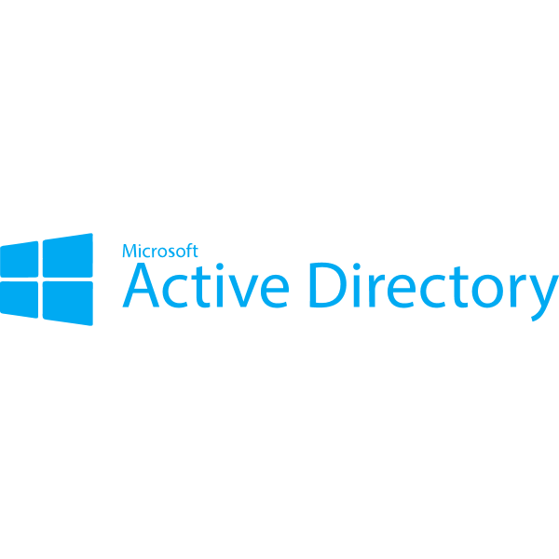


AWS Single Sign-On
On-Prem AD
AWS Accounts
Business Cloud Apps
dev
test
prod
Custom SAML Apps
Notes:
And AWS SSO enables you to log into multiple (click) AWS accounts—so maybe you have different accounts for dev, test and prod.
It integrates (click) nicely with your on-prem Active Directory.
You can use (click) it to work with external business cloud apps like Office 365, Slack, Dropbox, Salesforce and others.
And (click) you can also use it with custom SAML apps. So lots of different options here, and it’s a really nice way to just sign in once and be able to skip signing in everywhere else.
Now, SSO DOES require you to be using AWS Organizations, so let’s talk about those next.

Slide 54
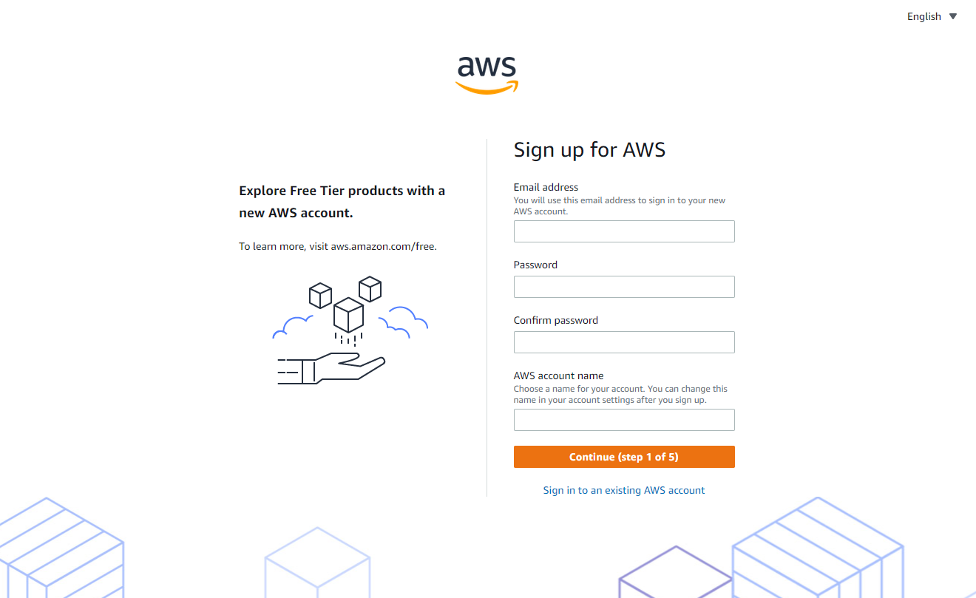
Notes:
m3-14 = “Accounts and Organizations Overview”
Way back in the beginning of the course, you’ll remember I showed you how to create a new AWS account, and that’s what we’ve been using. But if you’re in a large company, how does that work? What if you need to consolidate billing and pull usage reports across all the developers on the team, for example? Having everyone create individual accounts probably intuitively doesn’t seem right.

Slide 55

A policy attached at this OU level will apply to the Legal and HR accounts
ORGANIZATION
Root
OU
Root
Root
Root
Root
IT Dept Account
Finance Dept Account
Legal Dept Account
HR Dept Account
Notes:
When you need to manage one or more accounts, you’ll want to work with an AWS organization, which is basically a collection of accounts.
When you create the organization (click), it’s going to create the root. And then under that, you can have your accounts. Say, for example (click), that your IT department has their own AWS account, and then (click) Finance has their own account as well. And then another concept to introduce (click) is this idea of an organizational unit, or OU. This is an additional way you can group your accounts if they have similar requirements as far as security, regulation and general business needs. So under this, for example (click), maybe your Legal and HR departments want separate accounts, but because they’re similar in their requirements, you can put them both under that same organizational unit. And then any (click) policies you apply at the OU level will apply to all the accounts under there—so in our example, the Legal and HR department accounts.

Slide 56
Service Control Policy (SCP)
Used with AWS Organizations, SCPs let you define AWS services and actions that are allowed/disallowed
An additional layer beyond IAM
Notes:
Another concept to be familiar with is service control policies, or SCPs.
These come into play when you’re using AWS Organizations, and they let you define AWS services and actions that are allowed or disallowed on an account. So very similar to how IAM policies work, but this is just an additional layer that can be applied to an entire account. You can still use IAM with this.

Slide 57

ORGANIZATION
Deny the ability to create new EC2 instances
Root
OU
Root
Root
Root
Root
IT Dept Account
Finance Dept Account
Legal Dept Account
HR Dept Account
Notes:
Back to our example. Maybe for folks in the HR account, we want to say that they shouldn’t be able to spin up new EC2 instances. So we can apply that service control policy at the account level, and then anyone who’s part of that account wouldn’t be able to create a new EC2 instance.

Slide 58
ORGANIZATION
Root
Deny updates to CloudTrail
OU
Root
Root
Root
Root
IT Dept Account
Finance Dept Account
Legal Dept Account
HR Dept Account
Notes:
Or maybe for folks in the IT Department, for compliance reasons, they shouldn’t be able to change any CloudTrail logs or settings. So you can deny that.
You get the idea. On the exam, if you get questions about how to allow or deny things in the context of an AWS organization, then a service control policy should be the first thing that comes to mind.

Slide 59
DEMO
Working with Organizations, Accounts and AWS Control Tower
Notes:
Can be logged in with IAM user account for this demo
m3-15 = “DEMO: Working with Organizations, Accounts and AWS Control Tower”
In this demo, I’ll give you an overview of organizations and accounts, and then we’ll also briefly look at a service called AWS Control Tower.
In the Console, if we come into Organizations, you’ll see that you can create an organization, and with just that single click (be careful…don’t click this if you don’t want to become an organization!), it’ll create the structure with our Root and then the one account that I’ve been working with.
Here, you can add new OUs (create “My First OU”)
You can also, on the top right, create new accounts or invite existing accounts (show)
So this is pretty straightforward. But even with this, you’ll need to create your organizations manually, add and move accounts between organizations, apply policies and so on.
Let’s undo this organization…follow along with me in case you created the organization on purpose
Select Amber Israelsen and remove from organization
MasterCannotLeaveOrganizationException
This won’t work
On left nav, go to Settings→Delete organization
And now your member account will be a standalone again.
Okay, with that out of the way, let’s move on to talking about Control Tower (navigate here), which will simplify life a little. Control Tower sits on top of AWS Organizations. This basically automates a lot of that work AND importantly, applies best practices and offers guidance on how to manage your multi-account environment.
Slide…
To get started, you’d create a landing zone (click this), which is basically a multi-account starting point that’s created using best practices, and then you can build from there. On the left, you’ll see the steps that you need to go through. First, review your pricing and select regions. Then set up organization units, or OUs, like we saw a couple slides back. Then set up shared accounts and encryption. And finally, review and set up the landing zone.
While it’s free to use Control Tower, it does take about an hour to set everything up, and you won’t need to know these details for the exam so I’m going to skip going through this wizard. For the exam purposes, though, if you get a question about multi-account setup and best practices, then Control Tower should come to mind.

Slide 60

Notes:
Just like a control tower for an airport sits above the terminals and planes and so on, and is able to control multiple things at once, the same is true of Control Tower in AWS.
Back to demo…

Slide 61
Important Points to Remember
IDENTITY AND ACCESS MANAGEMENT (IAM)
Root account has permissions to do everything, including access to billing info
Do NOT use it for everyday work; use an IAM user instead
By default, IAM users have no permissions
Multi-factor authentication (MFA) can—and should—be enforced for the root account and individual users
Access keys are required for programmatic access (CLI, SDK)
Roles should be used to give permissions to other AWS services
Permissions are controlled by policies; give least privileges
If a permission isn’t given, then by default, it is denied
If two policies are in place, the most restrictive one “wins”
Notes:
m3-16 = “Authentication and Authorization: Important Points to Remember”
We’ve covered A LOT of things in this module, and you’ll need to remember a lot of things for the exam. So I’ve pulled out the important points here that you can use for your studies as sort of a cheat sheet.
For Identity and Access Management (IAM), remember:
-Root account has permissions to do everything, including access to billing info
-Do NOT use it for everyday work; use an IAM user instead
-By default, IAM users have no permissions
-Multi-factor authentication (MFA) can be enforced for the root account and individual users, and as a best practice, should, at the very least, be enabled for the root account
-Access keys are required for programmatic access (CLI, SDK)
-Roles should be used to give permissions to other AWS services
-Permissions are controlled by policies; give least privileges
-If a permission isn’t given, then by default, it is denied
-If two policies are in place, the most restrictive one “wins”

Slide 62
Important Points to Remember
AUTHENTICATION AND INTEGRATION TOOLS
Security Token Service
Used to grant temporary credentials to AWS (such as with AssumeRole)
Cognito
Recommended way to manage users for mobile and web-based applications
Managed Microsoft AD
Controls how Microsoft technologies (SharePoint, .NET, SQL Server) in a VPC interact with AWS resources
AD Connector
A proxy to on-premises Active Directory; all users managed on-premises
AWS SSO
Allows users to log in only once, and credentials are used across accounts and other applications
Organizations
A collection of accounts; required to use SSO
Service Control Policies (SCP) let you define allow/deny for an entire account

